Slide 1
MIS 321
Automated Testing

Slide 2
Automate Testing
Automate testing is the practice of writing code to test code.
These test run in an automated fashion, typically following each commit.
Code Base
Application Code
Test Code

Slide 3
Example
Let’s pretend we have this method somewhere in our application.
public double CalculateChange(double owed, double paid){
if(paid >= owed){
return (paid – owed);
} else {
return error;
}
}

Slide 4
Example – Testing Manually
Launch the application
Login
Navigate to the proper page
Fill out the form
Submit the form
Verify and document the results
REPEAT before every release
Imagine how many methods similar to this one are in an application

Slide 5
Example – Automated Testing
var result = CalculateChange(110.72, 120.00);
Verify(result == 9.28);
Code can be written to call the method with known inputs
The result can be compared against expected results
If the results do not match the system can “take action”
Log
Stop Commit
Ring Alarm Bells ☺

Slide 6
Benefits of Automated Testing
Obviously, you can test your code more often while spending less time
As important, you can catch bugs BEFORE merging to the code base
Is a predecessor to continuous deployment!
Allows you to refactor your code with less effort meaning less technical debt!

Slide 7
Types of Automated Testing
Unit Test
Tests a single unit of an application without concerns with external dependencies like files, databases, etc.
The CalculateChange example was a unit test
Quick to write and execute quickly
Doesn’t provide full picture. May be lots of issues that you won’t see until you test with dependencies.

Slide 8
Types of Automated Testing
Integration Test
Tests the application with its external dependencies
Takes longer to execute since they are reading and writing to files and databases

Slide 9
Types of Automated Testing
End-To-End Test
Drives an application through the UI
One way to accomplish this is to use tools that allow us to record a users interaction with the application and replay to compare results
Provides the greatest confidence in the reliability of the test since it mimics an actual user
Are very slow and brittle to changes. You get a lot of false fails.

Slide 10
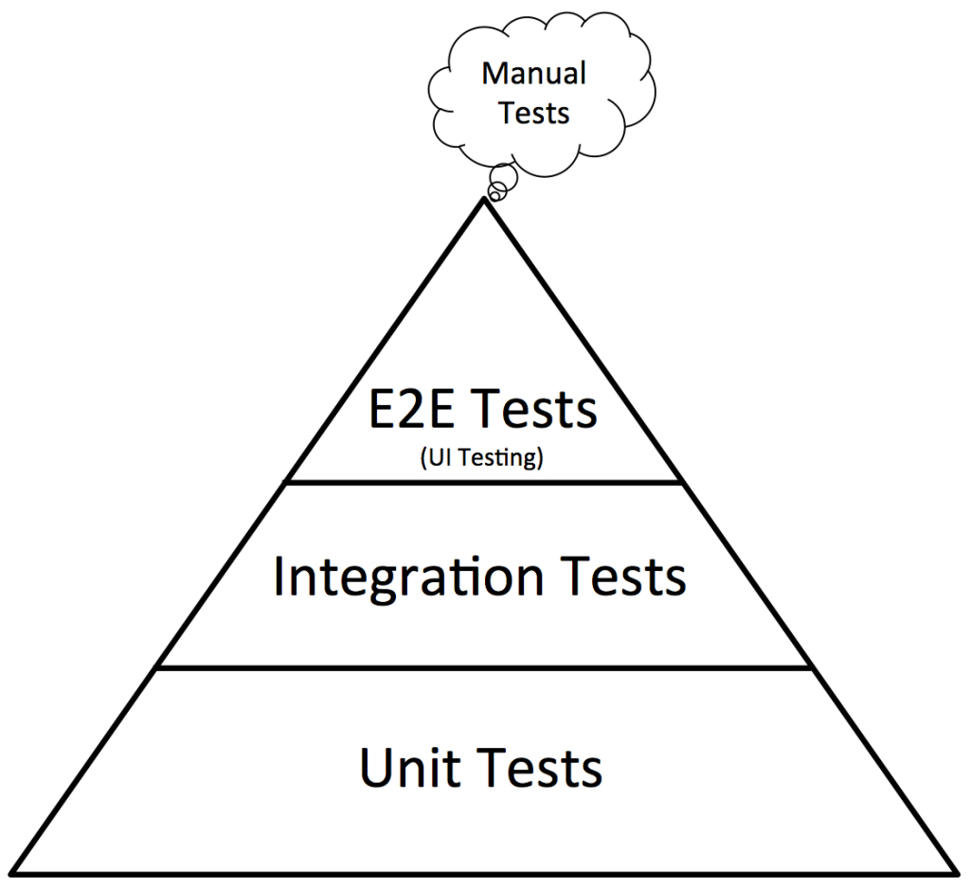
Which Type Should I Use?
Favor unit tests to end to end tests
Cover unit test gaps with integration tests
Use end to end tests sparingly. Primarily for the “happy path”.
Test edge cases in unit test.

